Slide 1


CMR TECHNICAL CAMPUS UGC (Autonomous) Kandlakoya, Medchal Road, Hyd-501 401 Department of Computer Science and Engineering
Major Project Review
DETECTING FAKE REVIEWS USING MULTIDEMENSIONAL REPRESENTATIONS WITH FINE GRAINED ASPECTS PLAN
-BY
R.Sanjana-207R1A0551
B.Ravikumar-207R1A0507
B.Farheen-207R1A0503
Project Guide:
Dr. V. Naresh Kumar
Associate Professor, CSE Department

Slide 2
ABSTRACT
Due to the rapid growth of network data, the authenticity and reliability of network information have become increasingly important and have presented challenges.
Most of the methods for fake review detection start with textual features and behavioral features. However, they are time-consuming and easily detected by fraudulent users.
Although most of the existing neural network-based methods address the problems presented by the complex semantics of reviews, they do not account for the implicit patterns among users, reviews, and products; additionally, they do not consider the usefulness of information regarding fine-grained aspects in identifying fake reviews.
In this project, we propose an attention-based multilevel interactive neural network model with aspect constraints that mines the multilevel implicit expression mode of reviews and integrates four dimensions, namely, users, review texts, products and fine-grained aspects, into review representations.
We model the relationships between users and products and use these relationships as a regularization term to redefine the model's objective function.
The experimental results from three public datasets show that the model that we propose is superior to the state-of-the-art methods; thus showing the effectiveness and portability of our model.

Slide 3
EXISTING SYSTEM
Detecting fake reviews is a crucial task for maintaining the integrity of online platforms. Various methods and systems have been developed to identify and mitigate fake reviews.
One of the most common methods involves sentiment analysis, where the sentiment of the review text is analyzed to determine if it's genuine or fake. Fake reviews often exhibit patterns such as overly positive or overly negative sentiments, which can be detected using machine learning algorithms.
NLP techniques are used to analyze the language patterns in reviews. This includes analyzing the grammar, syntax, and vocabulary used in the reviews. Fake reviews may exhibit inconsistencies or unusual language patterns that can be flagged by NLP algorithms.
Analyzing the behavior of reviewers can also help in identifying fake reviews. For example, if a reviewer consistently posts reviews for products from the same brand or if they post a large number of reviews in a short period, it could be indicative of a fake reviewer.
Machine learning models trained on labeled datasets of genuine and fake reviews can be used to automatically classify reviews as authentic or fake. These models can be trained using various features extracted from the reviews, such as sentiment, language patterns, and reviewer behavior.

Slide 4
DISADVANTAGES OF EXISTING SYSTEM
The system is less effective since it doesn’t preset SENTENCE-LEVEL INTERACTIVE ATTENTION NEURAL NETWORK MODULE.
The system doesn’t have MUTUAL ACTIVATION BETWEEN TEXT INFORMATION AND ASPECT INFORMATION

Slide 5
PROPOSED SYSTEM
The system proposes a new scheme to detect fake reviews using fine-grained aspects. In order to verify our scheme, the system proposes an attention-based multilevel interactive neural network model with fine-grained aspect constraints for fake review detection; this model can produce multidimensional dense sentence representations that incorporate user expression patterns, product fine-grained attributes, and contextual semantic information at the word and sentence levels.
The system models the relationship between users, review texts and products, use it as a regularization term to optimize the model's objective function, and incorporate the implicit relationship into the model.

Slide 6
ADVANTAGES OF PROPOSED SYSTEM
The system is more effective due to present of FINE-GRAINED ASPECT EXTRACTION.
The system is more accurate since it presents WORD-LEVEL FUSION.

Slide 7
SOFTWARE REQUIREMENTS
Operating system : Windows 7 or above
Coding Language : Python.
Front-End : Python.
Designing : Html, css, javascript.
Data Base : MySQL.

Slide 8
HARDWARE REQUIREMENTS
Processor : Intel i3 (or) Higher
RAM : 4GB (or) Higher
HDD : 500 GB (or) more

Slide 9
NOVELTY OF THE PROJECT
The novelty of a fake review detection system lies in its ability to distinguish between genuine and fake reviews with high degree of accuracy. Using advanced NLP algorithms to analyze the linguistic patterns , sentiment and coherence of review to identify anomalies that may indicate a fake review.
This could involve deep learning models like recurrent neural networks(RNNs) or transformer models like BERT. Integrating multiple modalities of data, including text, images and videos to provide a more comprehensive analysis of content and detect fake news across various mediums.

Slide 10
ARCHITECTURE
User
Data split into train and test data
Training data
Upload dataset
Testing data
Predict the result
Data Preprocessing
Analysis the result
Generate the graph
Feature extraction

Slide 11
MODULES
Upload Dataset
Uploading a dataset for fake reviews detection typically involves several steps to ensure that the data is properly formatted, cleaned and ready for analysis or model training.
Acquire dataset
Understand the dataset
Upload the dataset
Preprocess Dataset
Preprocessing a dataset for fake reviews typically involves several steps to clean and prepare the data for analysis or training a machine learning model.

Slide 12
TRAIN MACHINE LEARNING
This focuses on fake review detection according to the articles publishied. The fake news being predicted for given articles.
UPLOAD TEST DATA &PREDICT YIELD
Results reveals that random forest is the best classifier when all parameters are combined. This will not only help user in choosing the right article.

Slide 13
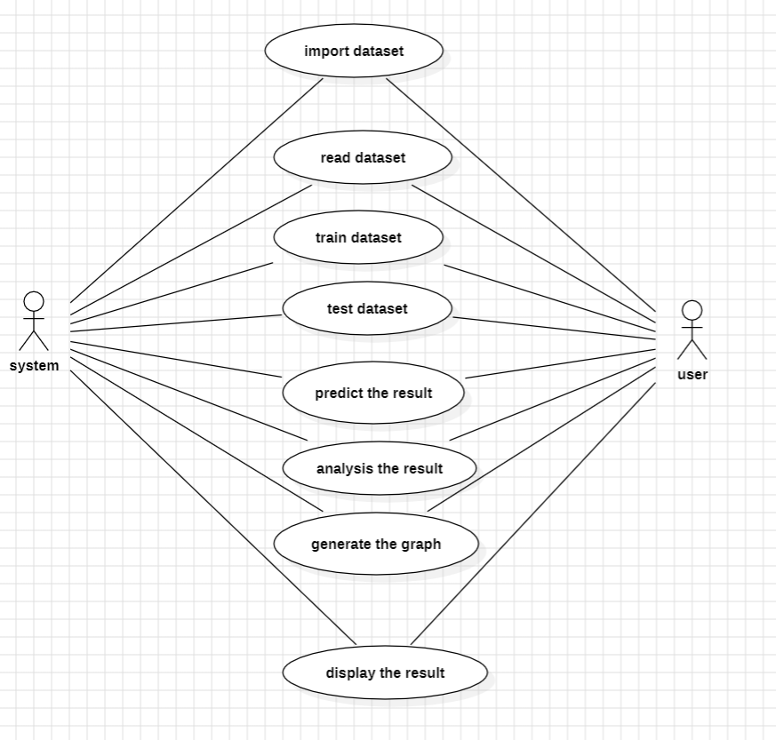
UML DIAGRAMS
Use case diagram

Slide 14
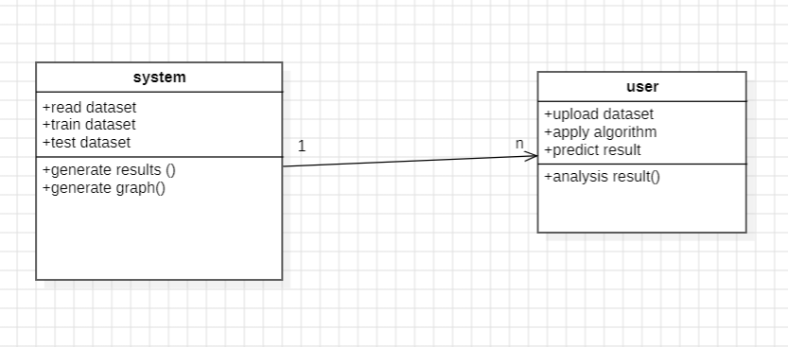
Class diagram

Slide 15
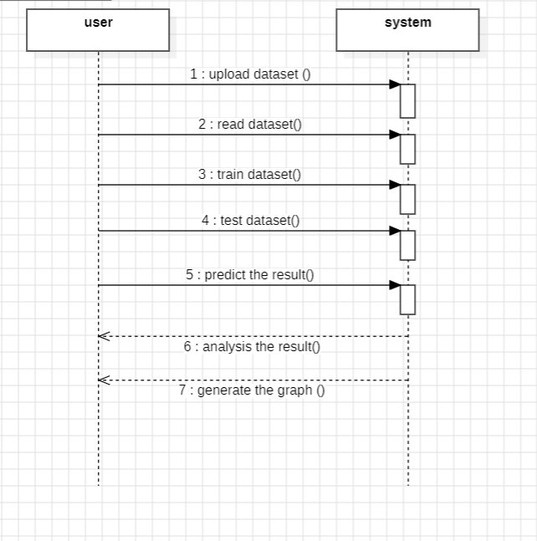
Sequence diagram:
:
:

Slide 16
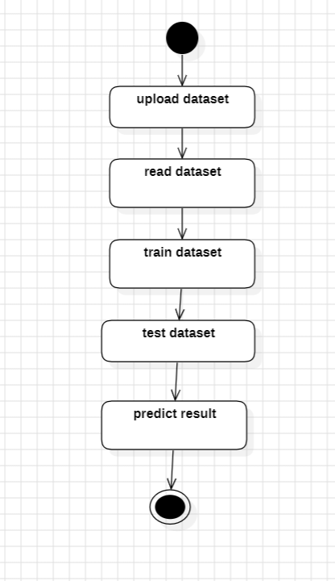
Activity diagram:

Slide 17
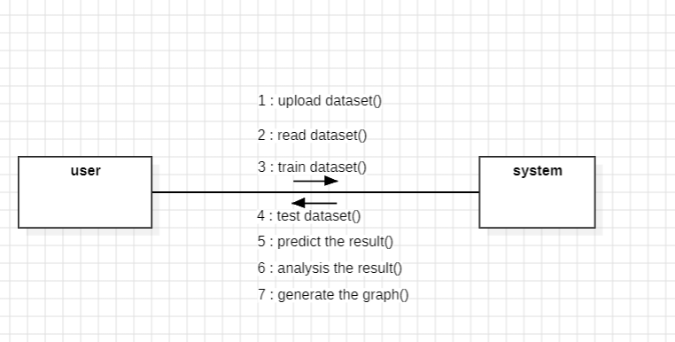
Collaboration diagram:

Slide 18
SAMPLE CODE
import os
import sys
def main():
os.environ.setdefault('DJANGO_SETTINGS_MODULE', 'FakeNews.settings')
try:
from django.core.management import execute_from_command_line
except ImportError as exc:
raise ImportError(
"Couldn't import Django. Are you sure it's installed and "
"available on your PYTHONPATH environment variable? Did you "
"forget to activate a virtual environment?"
) from exc
execute_from_command_line(sys.argv)
if __name__ == '__main__':
main()

Slide 19
from django.urls import path
from . import views
urlpatterns = [path("index.html", views.index, name="index"),
path("Login.html", views.Login, name="Login"),
path("AdminLogin", views.AdminLogin, name="AdminLogin"),
path("UploadNews.html", views.UploadNews, name="UploadNews"),
path("UploadNewsDocument", views.UploadNewsDocument, name="UploadNewsDocument"),
path("DetectorAlgorithm", views.DetectorAlgorithm, name="DetectorAlgorithm"),
]

Slide 20

RESULT
1:Click on user

Slide 21

2:Login into web application using login credentials

Slide 22

3:Click on upload news articles

Slide 23
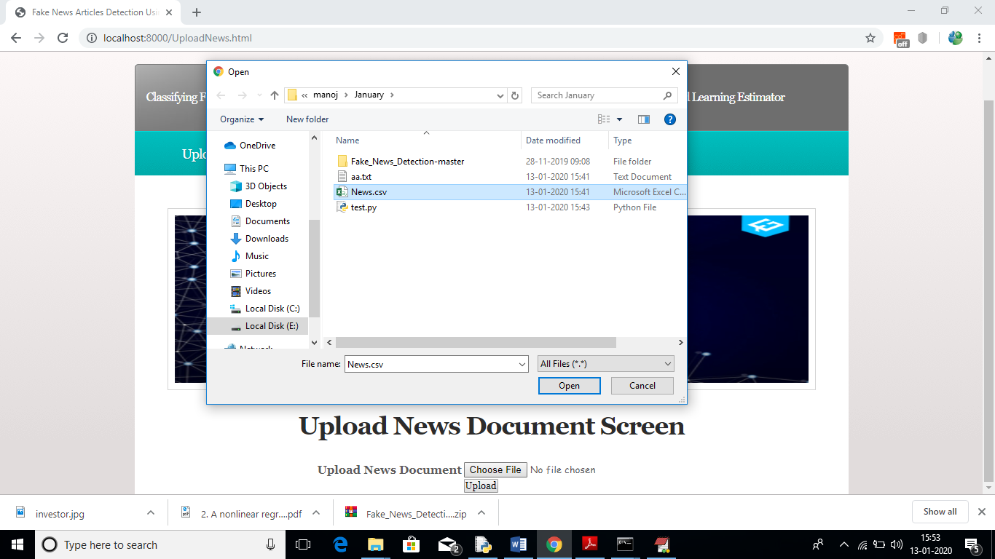
4:Click on choose file and upload the file

Slide 24

5:The document is loaded

Slide 25
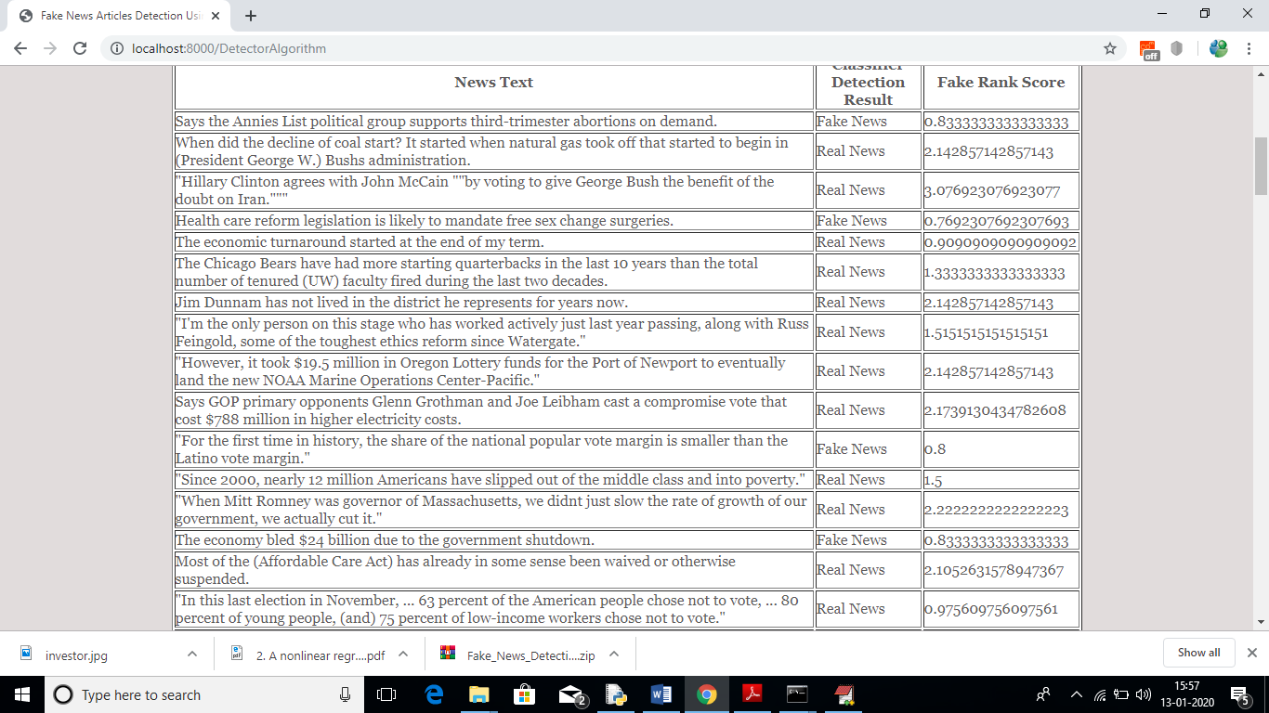
6:The results are displaying

Slide 26
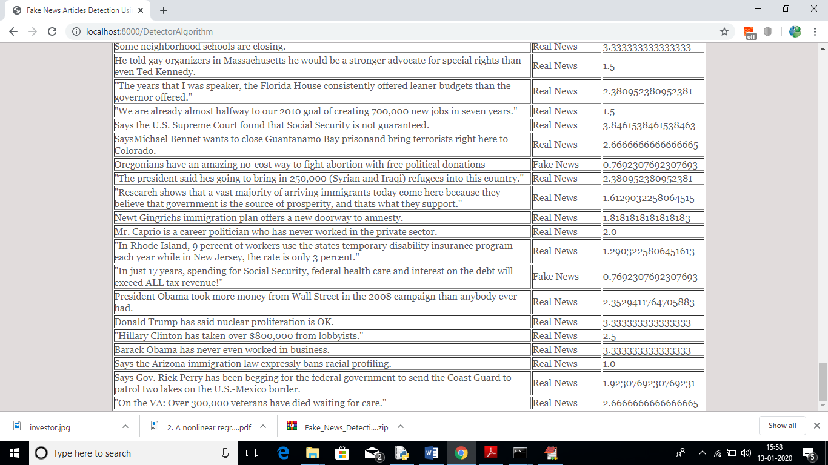

Slide 27
CONCLUSION
This project presented the results of a study that produced a limited fake news detection system. The work presented herein is novel in this topic domain in that it demonstrates the results of a full-spectrum research project that started with qualitative observations and resulted in a working quantitative model. The work presented in this project is also promising, because it demonstrates a relatively effective level of machine learning classification for large fake news documents with only one extraction feature. Finally, additional research and work to identify and build additional fake news classification grammars is ongoing and should yield a more refined classification scheme for both fake news and direct quotes.

Slide 28
FUTURE SCOPE
The detection of fake news is an evolving field with ongoing research and technological advancements . Analysis of various modalities, advancements in deep learning architectures such as graph neural networks and reinforcement learning.
Multimodal Analysis
Deep learning architectures
Explainable AI
Adversarial Robustness
Collaborative filtering and Network analysis
Ethical and Societal implications

Slide 29
REFERENCES
[1] H. Liu, T. Mei, J. Luo, H. Li, and S. Li, “Finding perfect rendezvous on the go: accurate mobile visual localization and its applications to routing,” in Proceedings of the 20th ACM international conference on Multimedia. ACM, 2012, pp. 9–18.
[2] J. Li, X. Qian, Y. Y. Tang, L. Yang, and T. Mei, “Gps estimation for places of interest from social users’ uploaded photos,” IEEE Transactions on Multimedia, vol. 15, no. 8, pp. 2058–2071, 2013.
[3] S. Jiang, X. Qian, J. Shen, Y. Fu, and T. Mei, “Author topic model based collaborative filtering for personalized poi recommendation,” IEEE Transactions on Multimedia, vol. 17, no. 6, pp. 907–918, 2015.
[4] J. Sang, T. Mei, and C. Sun, J.T.and Xu, “Probabilistic sequential pois recommendation via check-in data,” in Proceedings of ACM SIGSPATIAL International Conference on Advances in Geographic Information Systems. ACM, 2012.
[5] Y. Zheng, L. Zhang, Z. Ma, X. Xie, and W. Ma, “Recommending friends and locations based on individual location history,” ACM Transactions on the Web, vol. 5, no. 1, p. 5, 2011.

Slide 30
[6] H. Gao, J. Tang, X. Hu, and H. Liu, “Content-aware point of interest recommendation on location-based social networks,” in Proceedings of 29th International Conference on AAAI. AAAI, 2015.
[7] Q. Yuan, G. Cong, and A. Sun, “Graph-based point-of-interest recommendation with geographical and temporal influences,” in Proceedings of the 23rd ACM International Conference on Information and Knowledge Management. ACM, 2014, pp. 659–668.
[8] H. Yin, C. Wang, N. Yu, and L. Zhang, “Trip mining and recommendation from geo-tagged photos,” in IEEE International Conference on Multimedia and Expo Workshops. IEEE, 2012, pp. 540–545.
[9] Y. Gao, J. Tang, R. Hong, Q. Dai, T. Chua, and R. Jain, “W2go: a travel guidance system by automatic landmark ranking,” in Proceedings of the international conference on Multimedia. ACM, 2010, pp. 123–132.
[10] X. Qian, Y. Zhao, and J. Han, “Image location estimation by salient region matching,” IEEE Transactions on Image Processing, vol. 24, no. 11, pp. 4348–4358, 2015.

Slide 31
GITHUB LINK
https://github.com/Ravikumar1018/fake-reviews detection

Slide 32
THANK YOU

